Slide 1
Chapter 1: Introduction to PIC18
The PIC18 Microcontroller
Han-Way Huang
Minnesota State University, Mankato
June 2004
Copyright @ 2005 Delmar Thompson

Slide 2
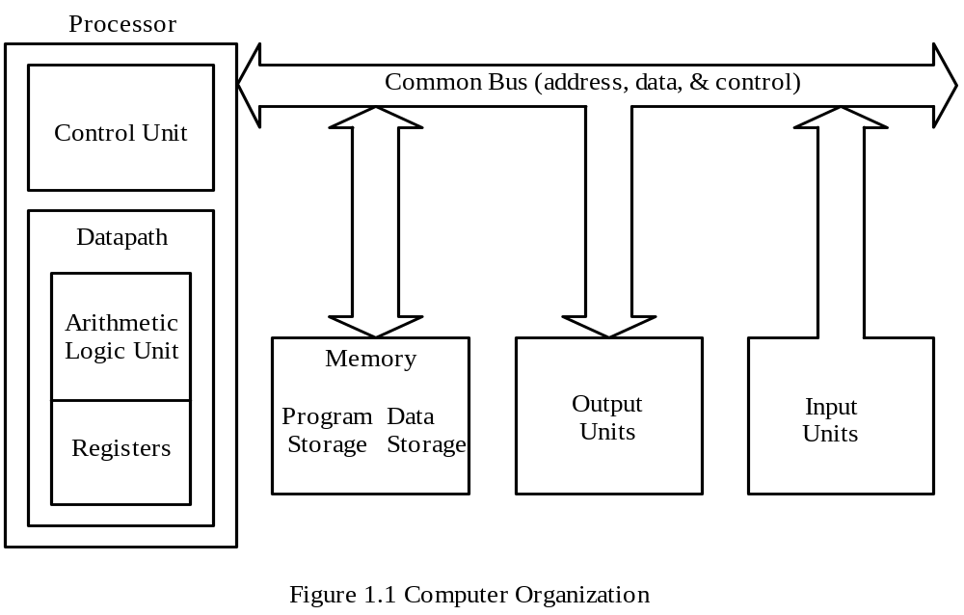
What is a computer?
Software
Hardware
Computer Hardware Organization
Copyright @ 2005 Delmar Thompson

Slide 3
The processor
Registers -- storage locations in the processor
Arithmetic logic unit
Control unit
program counter contains the address of the next instruction to be executed
status register flags the instruction execution result
The microprocessor
A processor implemented on a very large scale integration (VLSI) chip
Peripheral chips are needed to construct a product
The Microcontroller
The processor and peripheral functions implemented on one VLSI chip
Copyright @ 2005 Delmar Thompson

Slide 4
Features of the PIC18 microcontroller
- 8-bit CPU
- 2 MB program memory space
- 256 bytes to 1KB of data EEPROM
- Up to 3968 bytes of on-chip SRAM
- 4 KB to 128KB flash program memory
- Sophisticated timer functions that include: input capture, output compare,
PWM, real-time interrupt, and watchdog timer
- Serial communication interfaces: SCI, SPI, I2C, and CAN
- Background debug mode (BDM)
10-bit A/D converter
Memory protection capability
Instruction pipelining
Operates at up to 40 MHz crystal oscillator
Copyright @ 2005 Delmar Thompson

Slide 5
Embedded Systems
- A product that uses one or more microcontrollers as controller (s).
- End users are only interested in the functionality of the product but not on the microcontroller itself.
- Cell phones, home security system, automobiles, and many other products are examples of embedded products.
Copyright @ 2005 Delmar Thompson

Slide 6
Semiconductor memory
Random-access memory (RAM): same amount of time is required to access any location on the same chip
Read-only memory (ROM): can only be read but not written to by the processor
Random-access memory
Dynamic random-access memory (DRAM): need periodic refresh
Static random-access memory (SRAM): no periodic refresh is required
Read-only memory
Mask-programmed read-only memory (MROM): programmed when being manufactured
Programmable read-only memory (PROM): can be programmed by the end user
Copyright @ 2005 Delmar Thompson

Slide 7
Erasable programmable ROM (EPROM)
1. electrically programmable many times
2. erased by ultraviolet light (through a window)
3. erasable in bulk (whole chip in one erasure operation)
Electrically erasable programmable ROM (EEPROM)
1. electrically programmable many times
2. electrically erasable many times
3. can be erased one location, one row, or whole chip in one operation
Flash memory
1. electrically programmable many times
2. electrically erasable many times
3. can only be erased in bulk (either a block or the whole chip)
Copyright @ 2005 Delmar Thompson

Slide 8
Computer software
- Computer programs are known as software
- A program is a sequence of instructions
Machine instruction
- A sequence of binary digits which can be executed by the processor
- Hard to understand, program, and debug for human being
Assembly language
- Defined by assembly instructions
- An assembly instruction is a mnemonic representation of a machine
instruction
- Assembly programs must be translated before it can be executed --
translated by an assembler
- Programmers need to work on the program logic at a very low level and can’t achieve high productivity.
Copyright @ 2005 Delmar Thompson

Slide 9
High-level language
- Syntax of a high-level language is similar to English
- A translator is required to translate the program written in a
high-level language -- done by a compiler
- Allows the user to work on the program logic at higher level.
Source code
- A program written in assembly or high-level language
Object code
- The output of an assembler or compiler
Copyright @ 2005 Delmar Thompson

Slide 10
Source code and object code examples
address object code line no. Source code
----------------------------------------------------------------------------------------------
00001E 0E06 00010 movlw 0x06
000020 6E11 00011 movwf 0x11,A
000022 0E07 00012 movlw 0x07
000024 6E12 00013 movwf 0x12,A
000026 0E08 00014 movlw 0x08
000028 6E13 00015 movwf 0x13,A
00002A 0E05 00016 movlw 0x05
00002C 5E10 00017 subwf 0x10,F,A
00002E 5E11 00018 subwf x11,F,A
Copyright @ 2005 Delmar Thompson

Slide 11
Radix Specification
Hexadecimal (or hex) number is specified by adding the prefix 0x or by enclosing the number with single quotes and preceding it by an H.
0x02, 0x1234, H`2040’ are hex numbers
Decimal numbers are enclosed by single quotes and preceded by letter D.
D`10’ and D`123’ are decimal numbers
Octal and binary numbers are similarly specified.
O`234’ is an octal number; B’01011100’ is a binary number.
Copyright @ 2005 Delmar Thompson

Slide 12
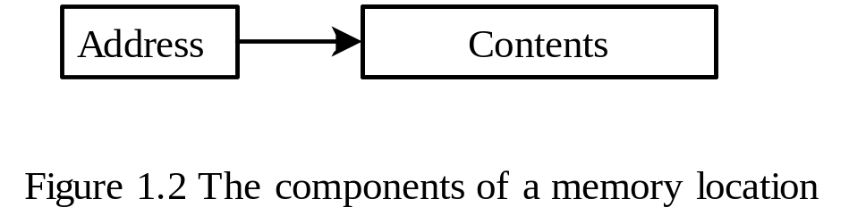
Memory Addressing
- Memory consists of a sequence of directly addressable locations.
- A location is referred to as an information unit.
- A memory location can be used to store data, instruction, and the status of
peripheral devices.
- A memory location has two components: an address and its contents.
Copyright @ 2005 Delmar Thompson

Slide 13
The PIC18 Memory Organization
Data Memory and Program Memory are separated
- Separation of data memory and program memory makes possible the
simultaneous access of data and instruction.
Data memory are used as general-purpose registers or special function registers
On-chip Data EEPROM are provided in some PIC18 MCUs
Copyright @ 2005 Delmar Thompson

Slide 14
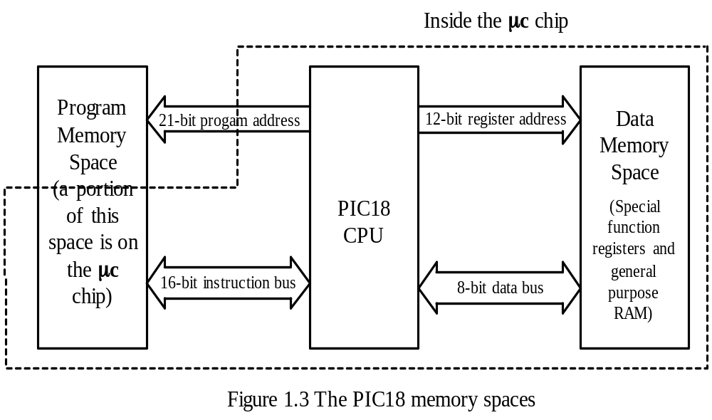
Separation of Data Memory and Program Memory
Copyright @ 2005 Delmar Thompson

Slide 15
PIC18 Data Memory
Implemented in SRAM and consists of general-purpose registers and special-function registers. Both are referred to as data registers.
A PIC18 MCU may have up to 4096 bytes of data memory.
Data memory is divided into banks. Each bank has 256 bytes.
General-purpose registers are used to hold dynamic data.
Special-function registers are used to control the operation of peripheral functions.
- Only one bank is active at any time. The active bank is specified by the BSR
register.
Bank switching is an overhead and can be error-prone
PIC18 implements the access bank to reduce the problem caused by bank switching.
Access bank consists of the lowest 96 bytes and the highest 160 bytes of the data memory space.
Copyright @ 2005 Delmar Thompson

Slide 16
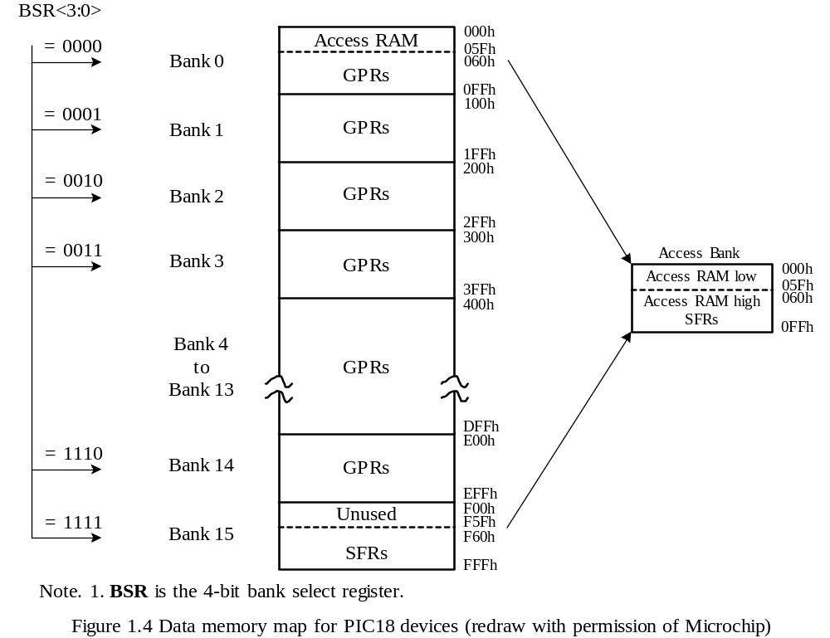
Copyright @ 2005 Delmar Thompson

Slide 17
Program Memory Organization
- The program counter (PC) is 21-bit long, which enables the user program to access up to 2 MB of program memory.
- The PIC18 has a 31-entry return address stack to hold the return address for subroutine call.
After power-on, the PIC18 starts to execute instructions from address 0.
The location at address 0x08 is reserved for high-priority interrupt service routine.
The location at address 0x18 is reserved for low-priority interrupt service routine.
Up to 128KB (at present time) of program memory is inside the MCU chip.
Part of the program memory is located outside of the MCU chip.
Copyright @ 2005 Delmar Thompson

Slide 18
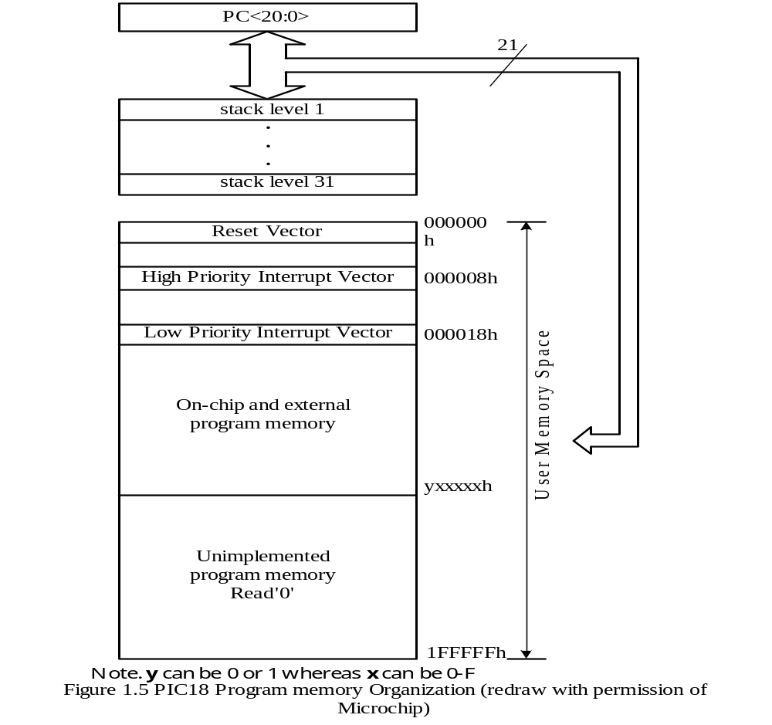
Copyright @ 2005 Delmar Thompson

Slide 19
The PIC18 CPU Register
The group of registers from 0xFD8 to 0xFFF are dedicated to the general control of MCU operation.
These CPU registers are listed in Table 1.2.
The WREG register is involved in the execution of many instructions.
The STATUS register holds the status flags for the instruction execution and is shown in Figure 1.6.
Copyright @ 2005 Delmar Thompson

Slide 20
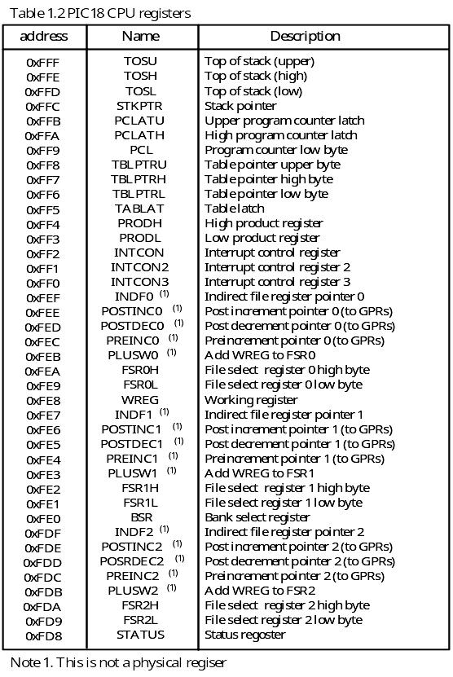

Slide 22
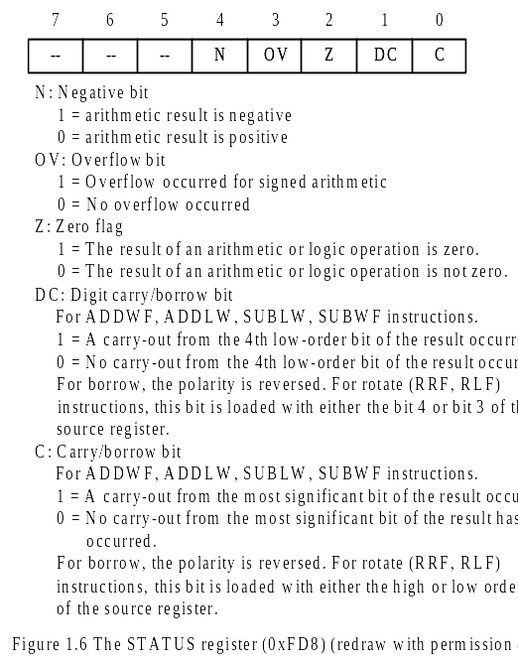
Copyright @ 2005 Delmar Thompson

Slide 23
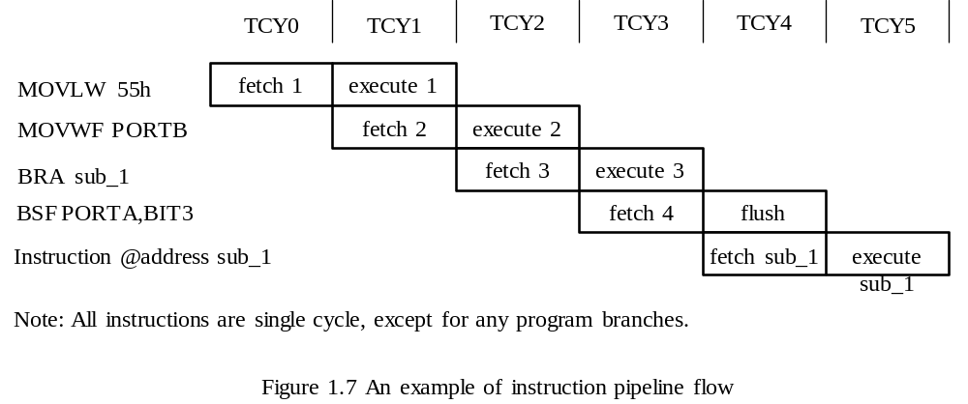
The PIC18 Pipelining
The PIC18 Divide most of the instruction execution into two stages: instruction fetch and instruction execution.
Up to two instructions are overlapped in their execution. One instruction is in fetch stage while the second instruction is in execution stage.
Because of pipelining, each instruction appears to take one instruction cycle to complete.
Copyright @ 2005 Delmar Thompson

Slide 24
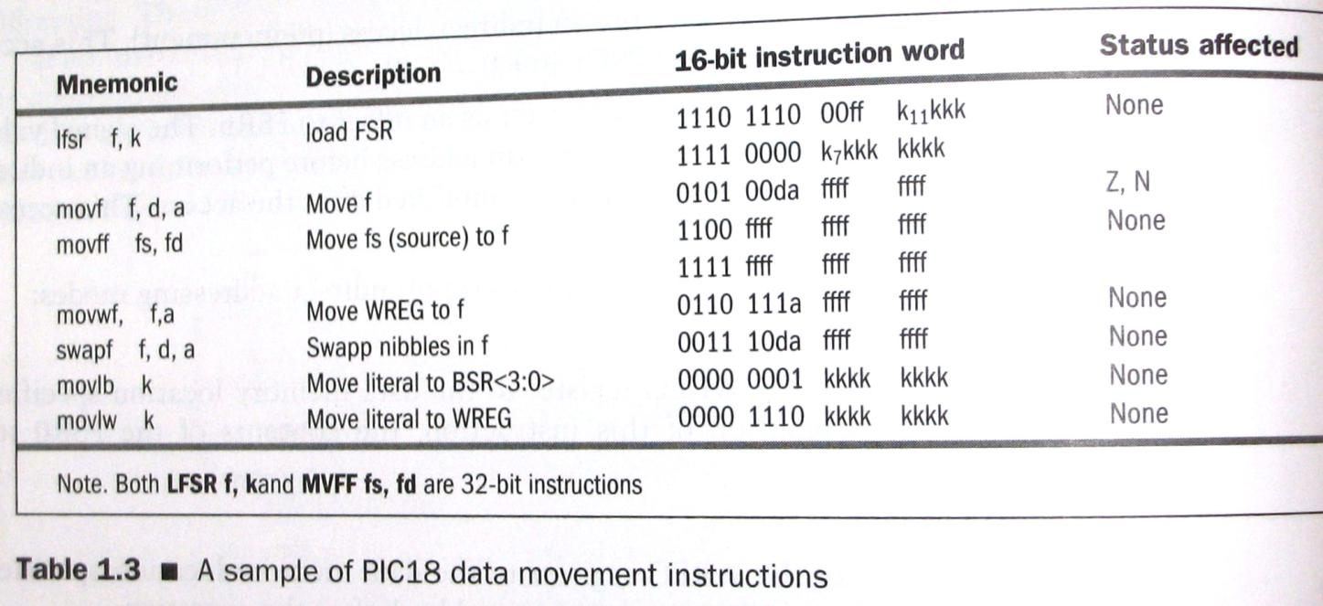
Sample of data movement instructions

Slide 25
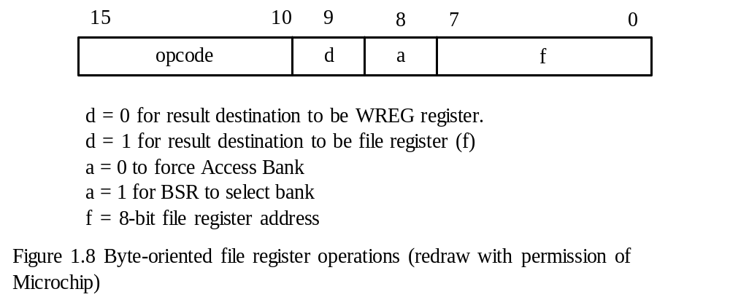
Instruction Format
- Format for byte oriented instructions
Copyright @ 2005 Delmar Thompson

Slide 26
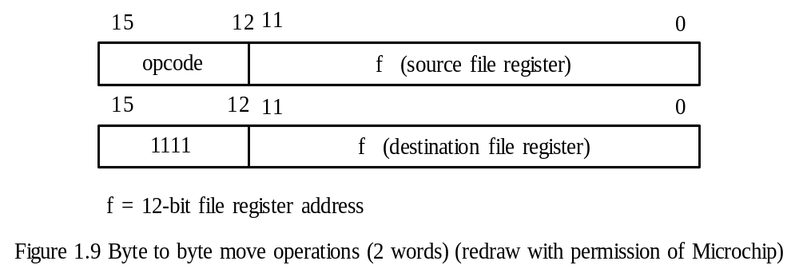
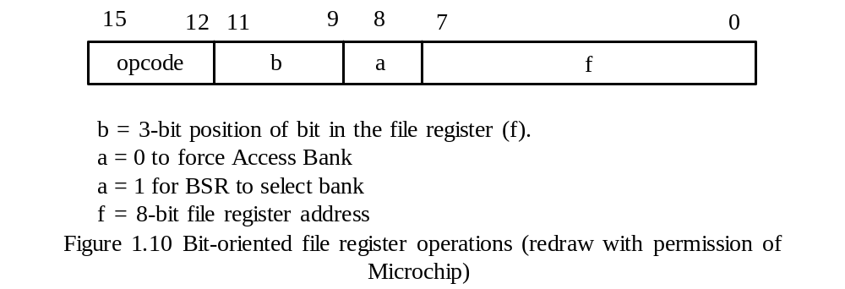
Byte-to-byte Operations
Bit-oriented file register operations
Copyright @ 2005 Delmar Thompson

Slide 27
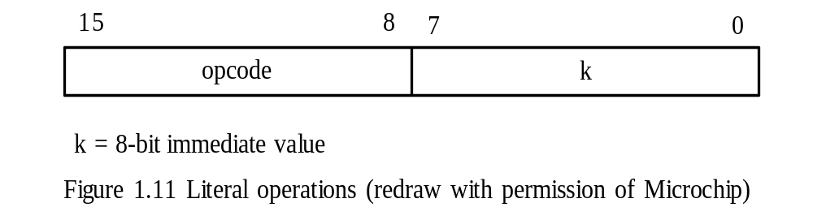
Literal operations
- A literal is a number to be operated on directly by the CPU
Control operations
- These instructions are used to change the program execution sequence and making subroutine calls.
Copyright @ 2005 Delmar Thompson

Slide 28
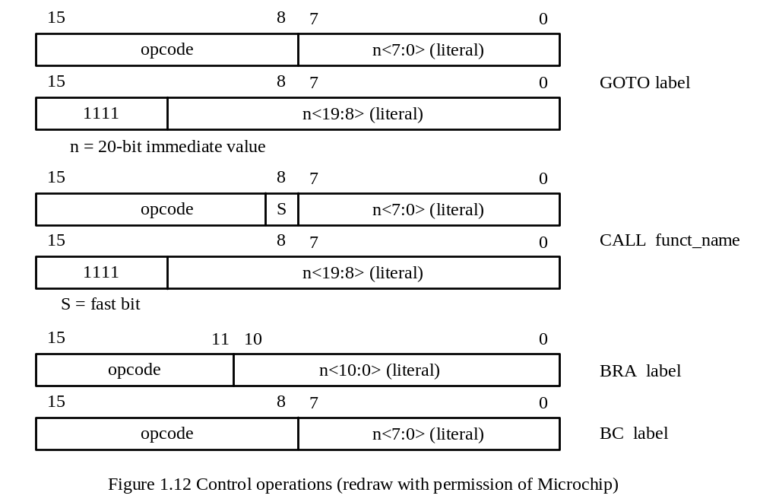
Copyright @ 2005 Delmar Thompson

Slide 29
Access Bank
In Figures 1.8 to 1.12, PIC18 uses 8 bits to specify a data register (f field).
Eight bits can specify only 256 registers.
This limitation forces the PIC18 to divide data registers (up to 4096 bytes) into banks.
Only one bank is active at a time.
When operating on a data register in a different bank, bank switching is needed.
Bank switching incurs overhead and may cause program errors.
Access bank is created to minimize the problems of bank switching.
Access bank consists of the lowest 96 bytes in general-purpose registers and the highest 160 bytes of special function registers.
When operands are in the access bank, no bank switching is needed.
Copyright @ 2005 Delmar Thompson

Slide 30
Examples of the Use of Access Bank
1. addwf 0x20,F,A ; add the data register at 0x20 in access bank with WREG ; register and store the sum in 0x20.
2. subwf 0x30,F,BANKED ; subtract the value of WREG from the data register ; 0x30 in the bank specified by the current contents ; of the BSR register. The difference is stored in ; data register 0x30.
3. addwf 0x40,W,A ; add the WREG register with data register at 0x40 in ; access bank and leaves the sum in WREG.
Copyright @ 2005 Delmar Thompson

Slide 31
PIC18 Addressing Modes
- Register direct: Use an 8-bit value to specify a data register.
movwf 0x20,A ; the value 0x20 is register direct mode
- Immediate Mode : A value in the instruction to be used as an operand
addlw 0x10 ; add hex value 0x10 to WREG
movlw 0x30 ; load 0x30 into WREG
- Inherent Mode: an implied operand
andlw 0x3C ; the operand WREG is implied
daw ; the operand WREG is implied
Copyright @ 2005 Delmar Thompson

Slide 32
Indirect Mode: A special function register (FSRx) is used as a pointer to the actual data register.
Format Example
INDFx x = 0, 1, 2 movwf INDF0
POSTINCx movff POSTINC0,PRODL
POSTDECx movf POSTDEC0,W
PREINCx addwf PREINC1,F
PLUSWx movff PLUSW2,PRODL
Copyright @ 2005 Delmar Thompson

Slide 33
PIC18 Instruction Examples
Data Movement Instruction
lfsr FSR1,0xB00 ; place the value 0xB00 in FSR1
movf PRODL,W ; copy PRODL into WREG
movff 0x100,0x300 ; copy data register 0x100 to data register 0x300
movwf PRODL,A ; copy WREG to PRODL
swapf PRODL,F ; swap the upper and lower 4 bits of PRODL
movb 3 ; load 3 into BSR
movlw 0x10 ; WREG ← 0x10
Copyright @ 2005 Delmar Thompson

Slide 34
Add Instructions
addwf 0x20,F,A ; add data register and WREG and place sum in WREG
addwfc PRODL,W,A ; add WREG, PRODL, and carry and leave sum
; in WREG
addlw 0x5 ; increment WREG by 5
Subtract Instructions
subfwb PRODL,F ; PRODL ← [WREG] – [PRODL] – borrow flag
subwf PRODH,W ; WREG ← [PRODH] – [WREG]
subwfb 0x10,F,A ; 0x10 ← [0x10] – [WREG] – borrow flag
sublw 0x10 ; WREG ← 0x10 – [WREG]
Copyright @ 2005 Delmar Thompson

Slide 35
RISC
CISC
Simple instruction set
Regular and fixed instruction format
Simple address modes
Pipelined instruction execution
Separated data and program memory
Most operations are register to register
Take shorter time to design and debug
Provide large number of CPU registers
Complex instruction set
Irregular instruction format
Complex address modes
May also pipeline instruction execution
Combined data and program memory
Most operations can be register to memory
Take longer time to design and debug
Provide smaller number of CPU registers
Copyright @ 2005 Delmar Thompson

